Slide 1
Document Retrieval System
Combining Non-Overlapping, Probabilistic, and Graph-Based Retrieval Models
Presented By: Ayesha Nadeem, 2021-CS-9

Slide 2
Agenda
01
02
03
04
05
06
Overview
Preprocessing
Gathering Documents
Retrieval Models
Part-of-Speech (POS) Tagging & Noun Extraction
Building an Inverted Index

Slide 3
01
Overview

Slide 4
Overview
Objective
To transform information retrieval from a simple matching exercise to an intelligent, context-aware exploration of knowledge, making it easier for users to discover relevant information across complex document collections
Why It's Needed
Semantic Understanding
Probabilistic Ranking
Contextual Analysis
Network-Based Relationships
Retrieval Model
User Query + Documents
Preprocessing
Indexing
Results of Retrieval

Slide 5
Real-world Problem
Problem Scenario: Academic Research Literature Management
Traditional Search Limitations
Imagine a PhD student in Climate Change Research who needs to review 10,000+ research papers from the last decade. He needs to find connections between Climate change, Renewable energy, Economic impact, Technological innovations.
Keyword matching fails
Manual review impossible
Missing critical interconnected research
No way to understand complex relationships

Slide 6
Real-world Problem
How Our Three Models Solve This
1. Non-Overlapping List Model
Problem Solved: Comprehensive Topic Coverage
Retrieves documents containing combinations of terms:
"Climate Change"
"Renewable Energy"
"Economic Impact"
Returns unique documents across these domains
Prevents redundant search results
Expands research discovery

Slide 7
Real-world Problem
How Our Three Models Solve This
2. Probabilistic Retrieval Model
Problem Solved: Intelligent Relevance Ranking
Ranks papers based on:
Term frequency
Contextual relevance
Statistical probability of importance
Highlights most significant research papers
Filters out less relevant documents
Provides quality-based research recommendations

Slide 8
Real-world Problem
How Our Three Models Solve This
3. Proximal Nodes Model
Problem Solved: Relationship Visualization
Creates a network showing:
Connections between research papers
Interdisciplinary links
Semantic relationships
Reveals hidden research connections
Shows how different research domains interact
Helps identify emerging research trends

Slide 9
Real-world Problem
Practical Outcome
The student can now:
Quickly identify most relevant papers
Understand research interconnections
Save months of manual research
Discover innovative research directions
Real-World Impact
Accelerates research discovery
Reduces information processing time
Enables cross-disciplinary insights
Supports complex decision-making

Slide 10
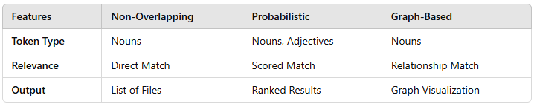
Overview
Comparison of Models

Slide 11
02
Gathering Documents

Slide 12
Gathering Documents
Purpose
Collects all .txt files from a specified folder path
Reads each file’s contents to create a dataset that can be used by other parts of the program.
Process
Opens each text file, reads content, and stores it in a list of dictionaries with title and content

Slide 13
03
Preprocessing

Slide 14
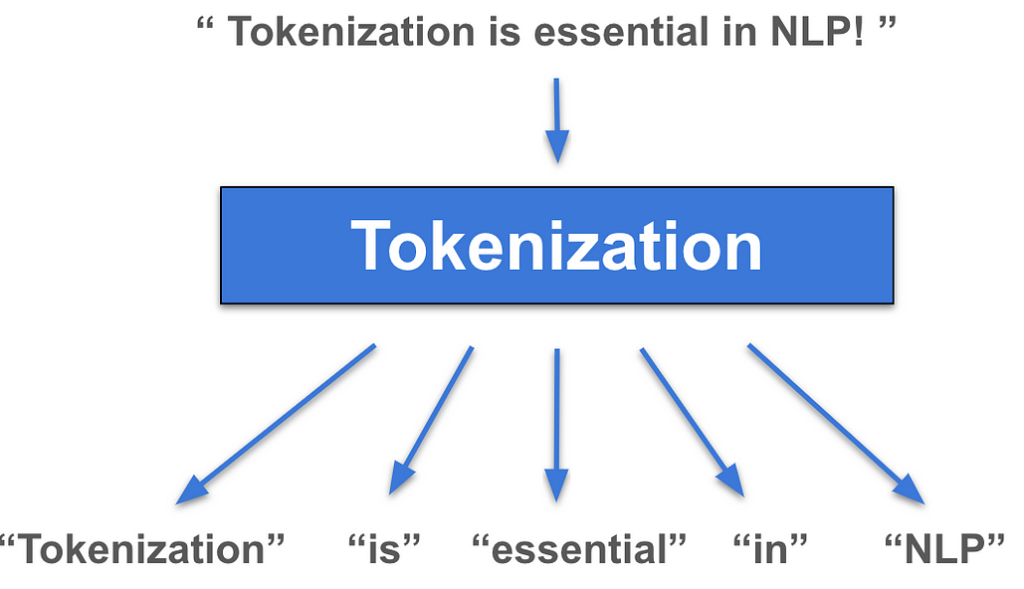
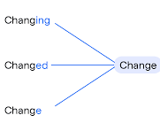
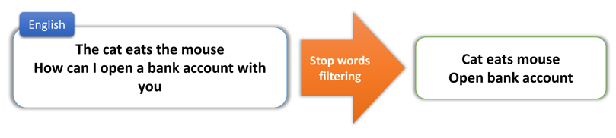
Preprocessing
Purpose
Prepares raw text for analysis by cleaning and structuring it.
To simplify the text and remove noise for further processing
Steps Involved
Tokenization
2. Lemmatization
3. Stop Words Removal

Slide 15
04
Part-of-Speech (POS) Tagging & Noun Extraction

Slide 16
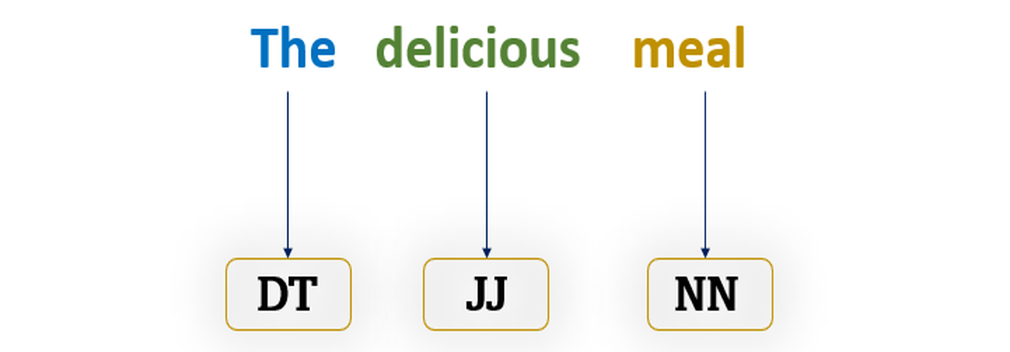
Part-of-Speech (POS) Tagging
Purpose
Assigns grammatical roles (like noun, verb, etc.) to each word.
Helps in filtering and focusing on specific types of words for search indexing.

Slide 17
Noun Extraction
Purpose
Identify and extract nouns from text as they represent core subjects or topics.
Why Nouns?
Nouns usually denote key concepts, themes, or entities in the text, such as people, places, or objects.
By focusing on nouns, the search engine indexes terms most likely to reflect document topics.

Slide 18
05
Building an Inverted Index

Slide 19
Building an Inverted Index
Purpose
Special noun acts as an index entry that maps to documents, making searches faster and reducing the need to scan entire texts repeatedly
How it works
For each document, splits content by paragraphs and extracts special nouns
Counts each noun’s occurrences in the document. Only nouns appearing more than once are recorded to emphasize key topics.
Adds nouns to an inverted_index dictionary, where keys are nouns, and values are dictionaries of document titles with count frequencies

Slide 20
06
Retrieval
Algorithms

Slide 21
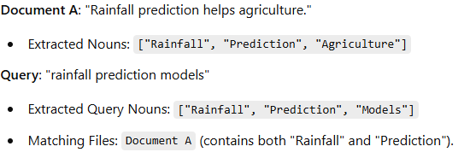
Non-Overlapping List Retrieval
Purpose
For a query, fetch documents that contain the query terms (nouns) without duplication.
Example

Slide 22

Probabilistic Retrieval (BIM)
Purpose
This method uses Jaccard Similarity to rank documents.
Jaccard Similarity
Used to determine the similarity between two text document.
How the two text documents close to each other in terms of their context
How many common words are exist over total words

Slide 23
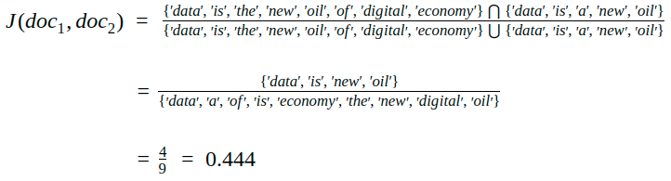
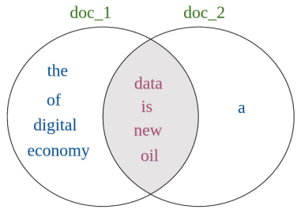
Probabilistic Retrieval (BIM)
Jaccard Similarity Example

Slide 24
Proximal Nodes
Purpose
Aims to capture the contextual relationships between terms within and across documents by representing them as nodes in a graph.
Graph Creation
Each keyword becomes a node.
An edge connects nodes if keywords appear in the document.
For a given query, identify all matching nodes (proximities).

Slide 25
Thank You

